Slide 1
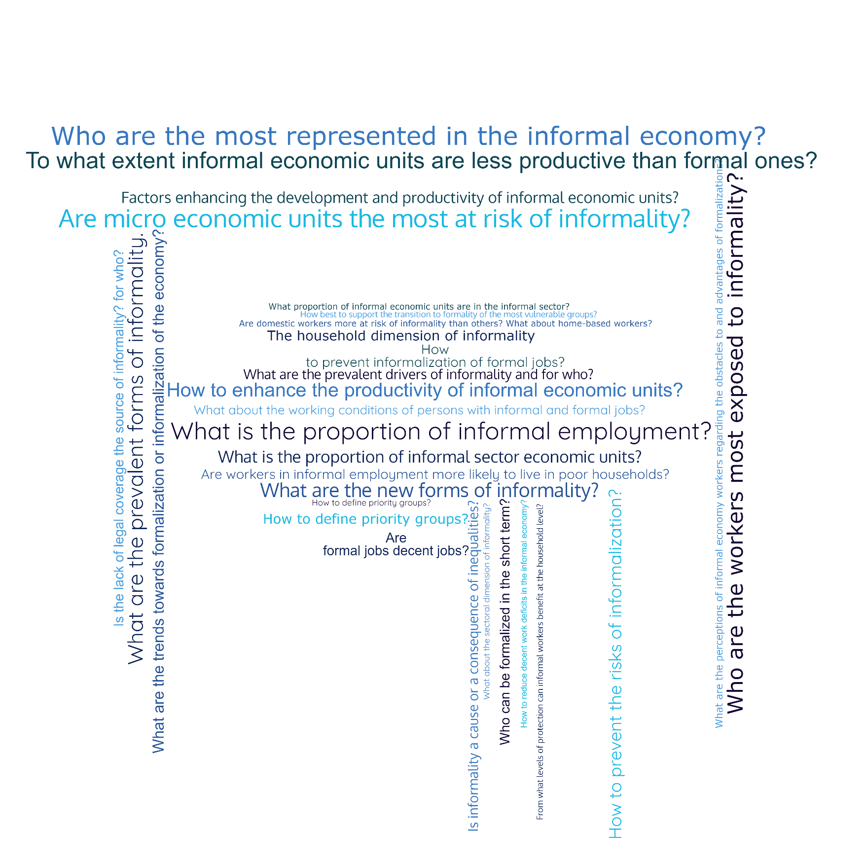
Session 2.3
A broad measurement of the informal economy, dimensions of informality and associated sources
ILO-SIAP Regional Course on Statistics on Informality: Definitions, Measurement, SDGs and Other Policy Indicators
Chiba (Japan), 15-18 October 2024
Florence Bonnet AP/FORMALIZATION (bonnet@ilo.org)

Slide 2
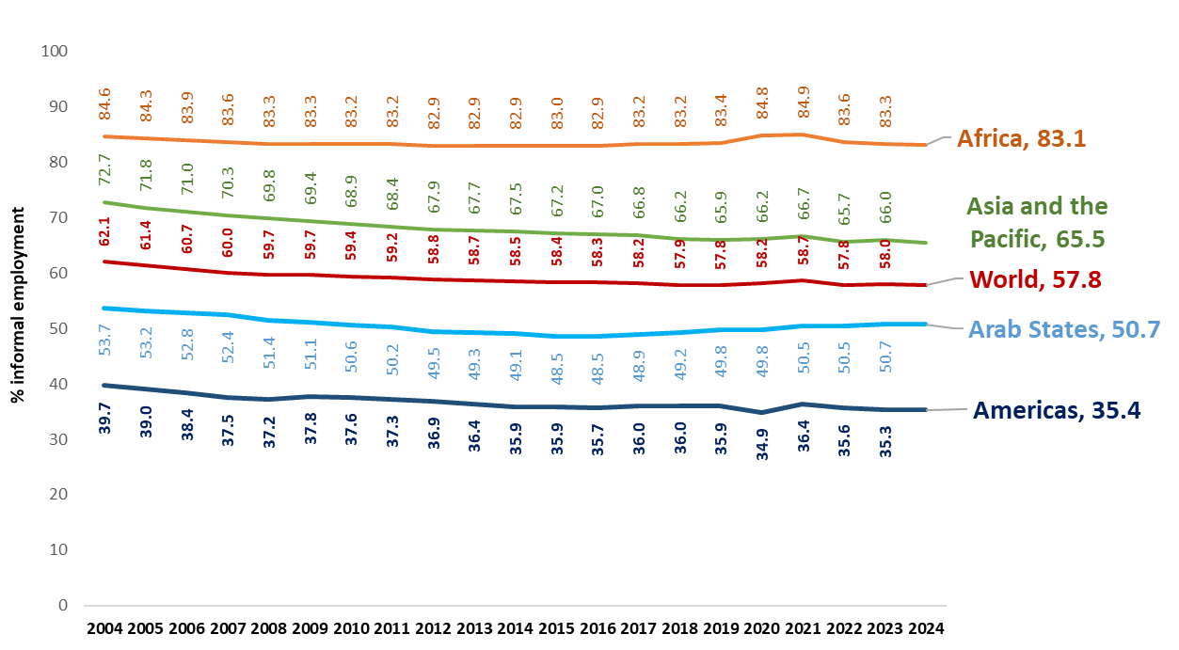
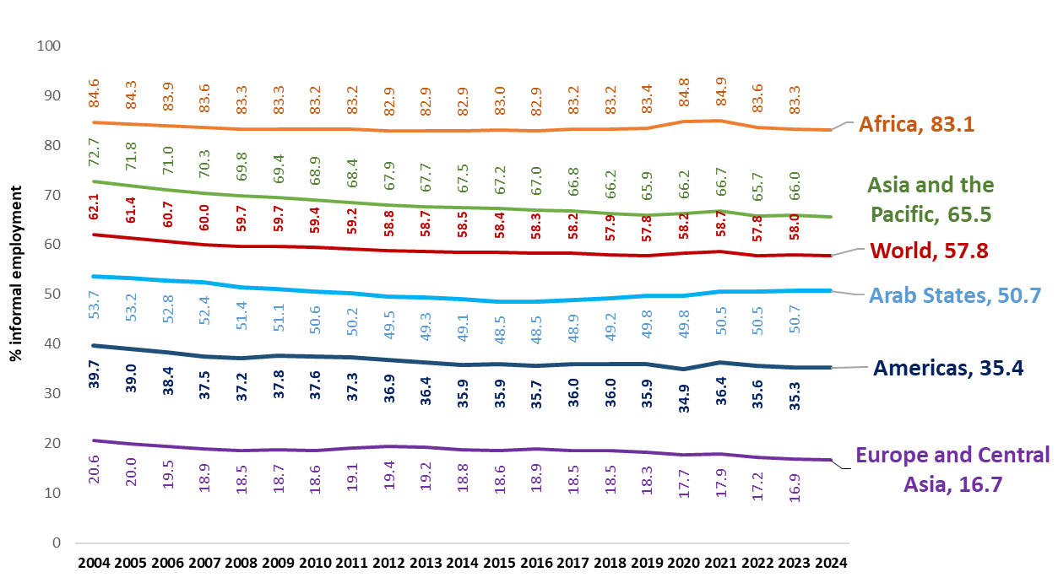
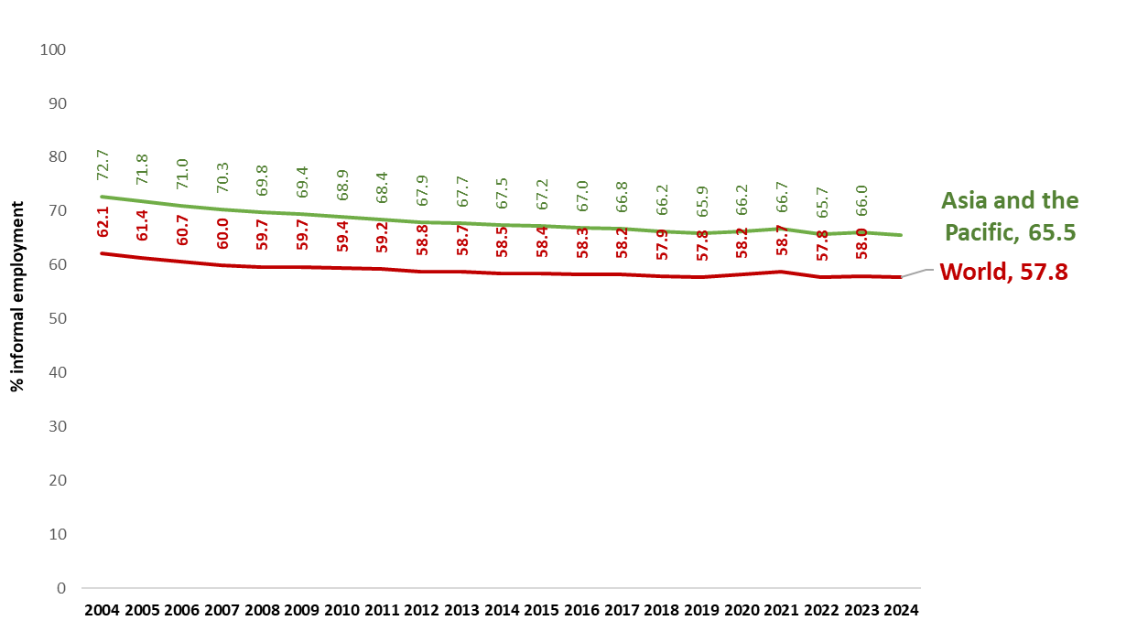
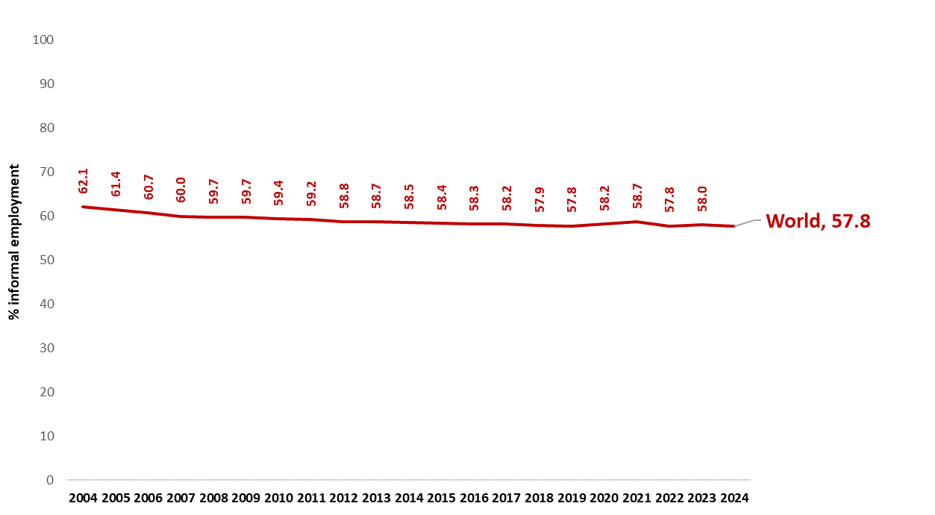
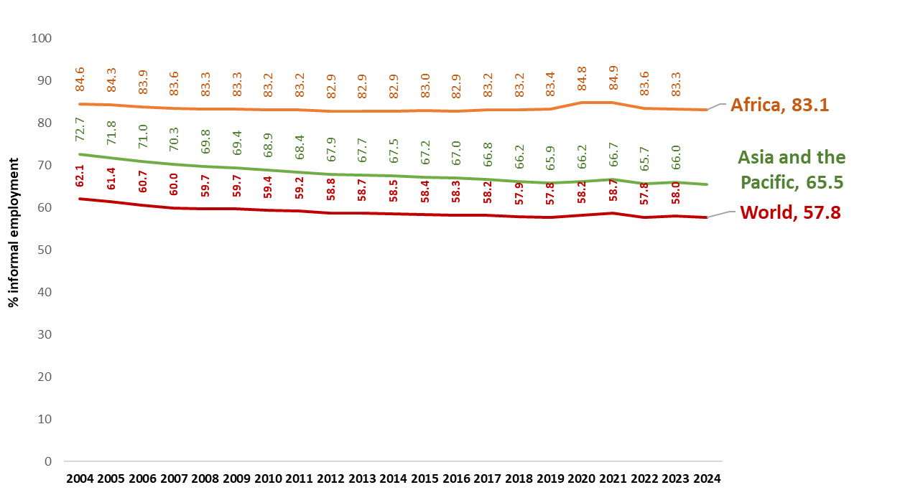
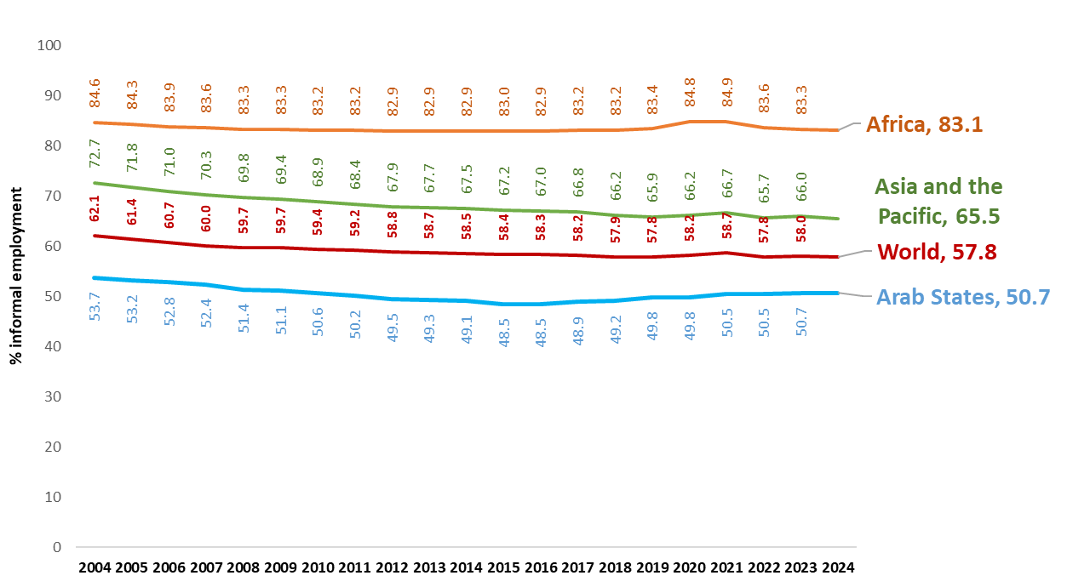
According to you what is the share of workers in informal employment?
Share of informal employment in total employment in…..
In the world
In Asia and the Pacific
In Africa
In the Arab States
In the Americas
In Europe and Central Asia
8/10
2/3
6/10
1/2
1/3
1/6

Slide 3

This is just one …
…of many questions

Slide 4


What would you like
to know about workers, economic units & activities in the informal economy?
This is just one …
…of many questions

Slide 5
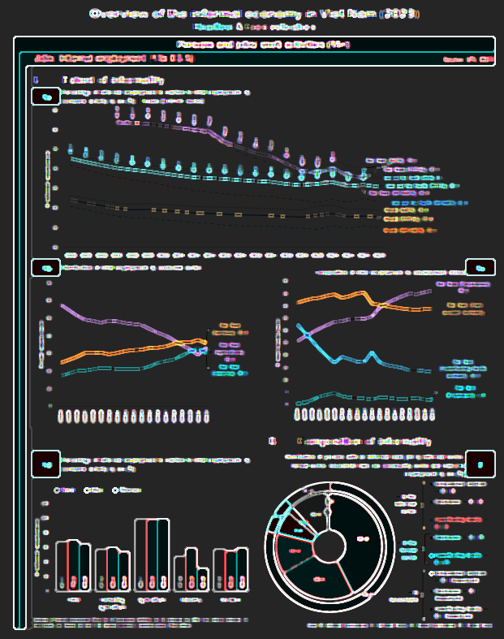
The informal economy indicator framework

Slide 6
Introduction
Indicators
    Situation
          An increasing number of countries in most regions collect data on informality, but still many countries:
          have some uncertainty on what data/ indicators to produce and how to use them
          are not necessarily engaged (yet) into addressing the challenges and consequences of informality for workers and economic units and facilitating their transition to formality
    Taking into account national context, priorities and objectives, indicators on informality have two interlinked objectives
          describe the situation of workers and economic units in the informal economy, highlight the heterogeneity and diversity of needs, working conditions and levels of protection of workers, economic performance & productivity of economic units and their contribution to the economy;
          …. going beyond the dichotomy formal/informal in order to …
          support the development of national policies and interventions taking into account the various stages, at the country level, in terms of understanding of the informal economy and political engagement in addressing the consequences of informality and facilitate transition to formality
    Alignment between the statistical resolution concerning statistics on the informal economy and Recommendation 204

Slide 7
The Informal Economy Indicator Framework
      Objectives
      Examples of questions
Indicators
        How to define priority groups?
        What formalization processes entail for who?
        How to move workers/units from lower to higher levels of formality?
        From what type and levels of protection do workers in informal employment benefit (protection/vulnerability) and how to improve protections along the process?
        Which workers or economic units are “ready or able” to formalize in a sustainable way and which are those for whom the reduction of decent work deficits are vulnerabilities is the only possible option in the short term?
        Are formal jobs decent jobs or how to ensure that formality = decent work?
        How to systematically link formalization of economic units and formalization of jobs?
        How to prevent informalization of formal jobs?
        How to support a gender-transformative transition to formality?
        What is the extent of informality? What about trends towards formalization or informalization?
        Which workers and economic units are most represented in the informal economy?
        What are the prevalent forms of informality?
        Which workers and economic units are the most exposed to informality?
        Are decent work deficits more pronounced in the informal economy?
        What are the working conditions of persons with informal and formal jobs?
        What about the relative level of productivity between informal economic units and formal ones?
        What are the factors constraining or enhancing the development and productivity of informal economic units or formal economic units?
        What about the gender dimension of informality?
        Organized into “broad questions or dimensions” and units of reference that refer to the main components of the informal economy (informality of jobs and work activities, of economic units and of “productive activities” (informal production and contribution to GDP)
        Categorized into headlines, main and additional indicators
        Link indicators to key questions to (a) understand/describe and (b) support the development and implementation of policies
        Dynamic: initial structure and set of indicators to be expanded beyond 2023 (online tools + extracts)
    1. Describe the informal economy and build a shared understanding of the situation (size, characteristics, causes and consequences)
    2. Support the development and implementation of policies to address the challenges associated to informality and facilitate the transition to formality

Slide 8
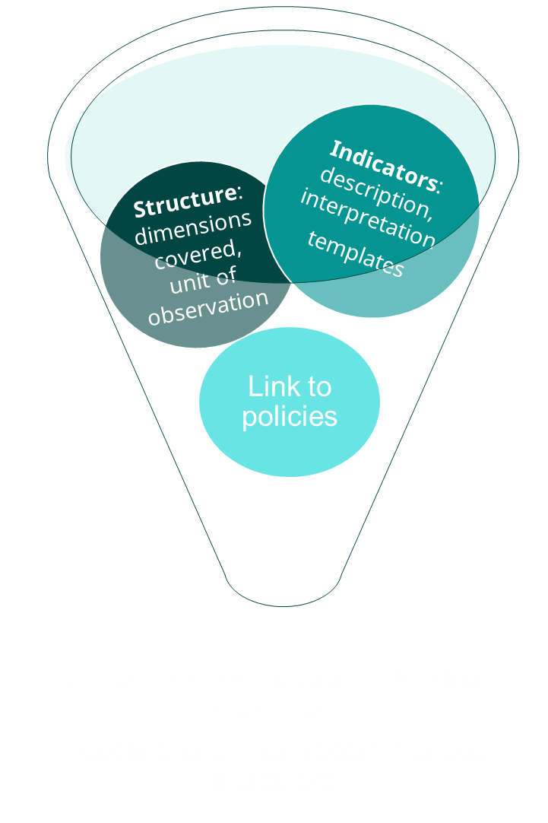
The indicators in the resolution and the broader Informal Economy Indicator Framework
Informal Economy Indicator Framework
    The indicators recommended in the resolution are supported by a broader Informal Economy Indicator Framework: both aim at covering the different components of the informal economy as defined in the conceptual framework
          The resolution includes indicators able to capture informality in its multiple dimensions with indicators referring to:
            persons, jobs and work activities: informal employment, partly informal productive activities; essential categories of informal work other than employment
            economic units: the informal sector
            the contribution of the informal economy to GDP (informal production)
          The (broader) Informal Economy Indicator Framework includes and expands the indicators recommended in the resolution
            A dynamic framework that will continue to be developed (online tool)
            Composed of a set of questions linked to indicators with associated templates and guidance (incl. recommended disaggregation, interpretation, etc.)
          Responds to the multiple needs and priorities of countries
            Flexibility to serve multiple purposes
            Enable all countries to produce and interpret at least a minimum set of indicators considered "essential“, namely ‘headline indicators’

Slide 9

Indicators are organized around 6 dimensions
          Indicators are organized around six dimensions analyzed across i) persons, jobs and work activities, ii) economic units and iii) informal productive activities carried out by persons and economic units
Persons, jobs and work activities
Economic units
Informal productive activities (contribution to GDP)
Informal employment
Partly informal activities
Work activities (other)
Informal sector
Main dimensions
A. Extent of informality
A. Extent of informality
          Extent of informality - the prevalence of informality across jobs, work activities, economic units and productive activities [Monitoring, including of SDG 8.3.1 and awareness raising]
            Working conditions: Incl. indicators comparing the situation of workers in informal and formal employment in relation to:
    (Labour-) income security: e.g. monthly and hourly average employment income; percentage of persons earning less than defined benchmarks
    Employment security: e.g. type and duration of employment agreement
    Place of work: fixed-visible premises, own-home and others’ home, others
    Working time: e.g. distribution by range of actual hours and average number of weekly hours and time related under-employment
    Representation security: e.g. affiliation to a union, a professional organization, a workers’ association or a member-based organization of workers; coverage of employees by one or more collective agreements
    Health and safety issues: e.g. prevention, exposure, injuries and compensation
    Skills-security: e.g. access to training/ retraining
B. Composition of informality
B. Composition of informality
          Composition of informality - the distribution of informal and formal jobs, work activities and economic units by socio-demographic, employment-related characteristics and characteristics of the economic units and socio-demographic characteristics of the owner or owners.
            Identification of the prevalent forms of informality; of groups most represented in numbers in informal employment, informal work activities, informal sector economic units  Can support agreement on priority groups for policy interventions
C. Exposure to informality
          Exposure to informality - the percentage of persons in informal employment and of economic units in the informal sector by socio-demographic, employment-related characteristics and characteristics of the economic units and socio-demographic characteristics of the owner or owners;
            Identification of some of the drivers of informality associated to socio-demographic, employment related and enterprise features; identify categories of workers and economic units most at risk of informality  can support the definition of priority groups
C. Exposure to informality
          Working conditions and levels of protection for those in informal and formal employment, productivity and factors constraining or enhancing the development and sustainability of informal economic units and formal ones (incl. in their capacity to provide formal decent jobs for the owner and for employees)
            Contributes to identify various levels of protection and/or of vulnerability associated to informal and formal jobs and possibly work activities; identify the extent of decent work deficits, including whether formal jobs mean decent jobs; contributes to the assessment of workers and economic units “readiness” to formalize in a sustainable way in the short term
D. Working conditions & productivity
D. Working conditions & productivity
          Contextual vulnerabilities – including in respect of poverty, income and social protection from all sources and for all household members and in respect of the composition of households, such as households with people in formal employment or households with at least one member contributing to social security
            Complements the assessment of levels of protection and vulnerability associated to people’s own job to consider sources of protection or vulnerability within households and beyond the world of work
E. Contextual vulnerability
          Other structural factors - factors linked to the labour market structure and macroeconomic context: structure of employment in terms of employment status, sectors, forms of employment and work that are more likely to be informal; growth and sectoral composition of growth
            Complements the analysis of drivers of informality; identify structural factors of informality as part of the labour market and the economy.
E. Contextual vulnerability
F. Other structural factors
F. Other structural factors

Slide 10

Going beyong the dichotomy formal - informal
Formal jobs, productive activities
“Protection against personal and economic risks”: decent work
Does formalization mean protection against personal & economic risks? Are formal jobs decent jobs?
  Working conditions among workers in formal employment
  Productivity & performance of formal economic units

+
….incl. Preventing informalization
Transition to formality…
Level of protection against economic and personal risks
-
+
From what protections do workers in informal employment benefit?
Under Dimension 4. Working conditions & productivity:
  Income security; levels of protection; level & forms of organization / representation
  Productivity of enterprises
  Under Dimension 5. Contextual vulnerabilities
  Broader assessment of income security: from all sources & from all household members

Most pronounced decent work deficits, low productivity
-
Informal jobs, productive activities

Slide 11
From the indicator framework to indicators included in the resolution
Units of reference
Persons, jobs and work activities
Economic units
Informal productive activities (contribution to GDP)
Informal employment
[§§128-133]
Partly informal activities [§134]
Work activities (other) [§135]
Informal employment
[§§128-133]
Informal employment
[§§128-133]
Informal employment
[§§128-133]
Informal employment
[§§128-133]
Partly informal activities [§134]
Work activities (other) [§135]
Informal sector
Partly informal activities [§134]
Work activities (other) [§135]
Main dimensions
Partly informal activities
Extent of undeclared earnings & hours
(other) Informal work activities
Extent of informality among essential forms of work
If times allows: quick presentation of the indicators recommended in the resolution concerning statistics on the informal economy
Extent of informality
Headline indicators
% of informal employment
Prevalent forms of informality
Characteristics of workers in informal employment compared to workers in formal employment
Workers most at risk of having informal jobs
Extent of informality of economic units
Extent of informality
Extent of informality
Contribution to GDP
2. Composition of informality
2. Composition of informality
Characteristics of informal economic units & owners
3. Exposure to informality
3. Exposure to informality
Economic units & owners most at risk of operating informally
Session 3.1
4. Working conditions & productivity
4. Working conditions & productivity
4. Working conditions & productivity
4. Working conditions & productivity
Levels of protection (job related) & working conditions
Productivity & eco performance; underlying factors
Session 3.2
+ Levels of protection & vulnerability within households
5. Contextual vulnerabilities
5. Contextual vulnerabilities
5. Contextual vulnerabilities
Legal & institutional framework
6. Other structural factors
6. Other structural factors
Session 3.3
Structure of the labour market and of the economy

Slide 12
Relevance for specific groups & the gender dimension
Overall target population
Specific sectors
Domestic workers
Persons with disabilities
Migrant workers
Home-based workers
Digital platform workers
    Relevance for specific groups: The indicators recommended in the resolution (and in the broader indicator framework) are relevant for the overall target population as well as for specific categories of workers or economic units providing that the sample design and size allow for reliable estimates
Informal economy indicators
    Informality from a gender perspective
      The resolution
      Calls notably for the systematic disaggregation by sex of all indicators related to persons, and by sex of the owner/owners of economic units for all enterprise-related indicators
      Includes reference to specific gender indicators such as the gender pay gap, time spent on unpaid domestic and care work
      Supports the identification and assessment of the situation of workers in male or female-dominated economic activities, occupations or places of work

Slide 13
Recommended disaggregation for persons & jobs
Disaggregation
    Indicators related to persons and jobs should be disaggregated by:
          Sex and other relevant socio-demographic characteristics
            Including: including by age, educational level, area of residence (urban or rural) and geographical region.
          Employment-related characteristics:
            Including: status in employment, economic activity, occupation, place of work, size of enterprise, duration of the employment agreement and number of hours worked (hour bands).
          Where sample size and the representativeness of results allow, it is recommended to have multiple levels of disaggregation to highlight intersectionality:
            For example, sex in combination with status in employment
            Allows assessing intersectionality (e.g. differences between women and men defined as informal employees or informal contributing family workers and so on).
          More guidance on recommended disaggregation (+ associated templates) will be provided in the accompanying indicator framework.

Slide 14
Recommended disaggregation for economic units
Disaggregation
    Indicators related to economic units should be disaggregated by:
          industry of economic activity, size of enterprise (number of employees and business owner), level of output or sales, level of output or of value added per worker, level of profits and place of work.
          the socio-demographic characteristics of the owner or owners, including sex, age, educational level, area of residence (urban or rural) and geographical region, as relevant in the country.
          The accompanying indicator framework provides more guidance on recommended disaggregation

Slide 15
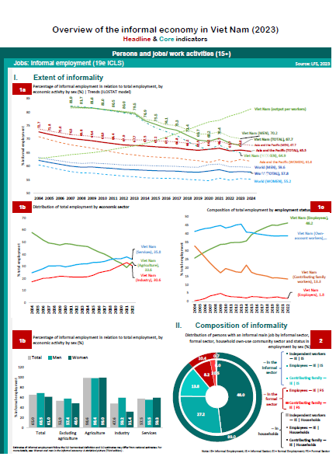
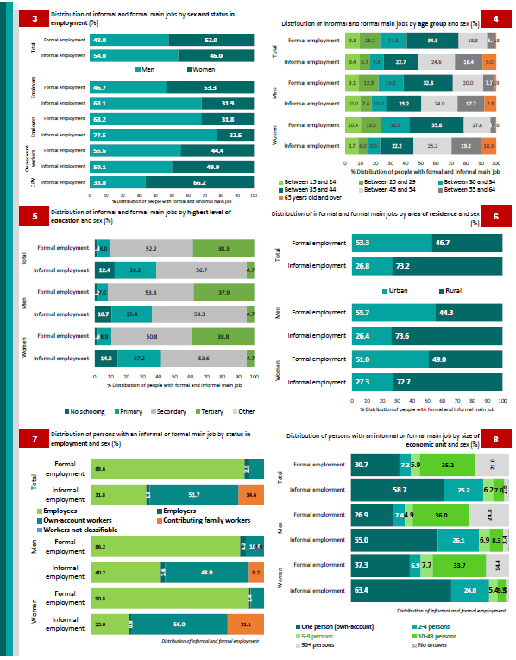
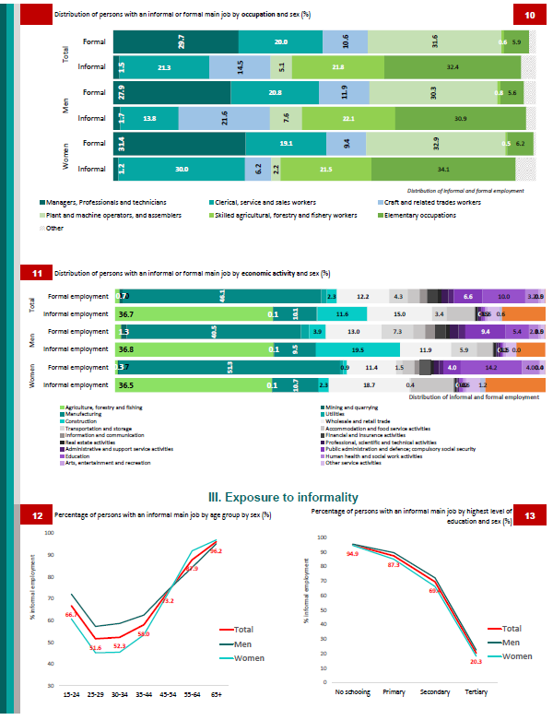
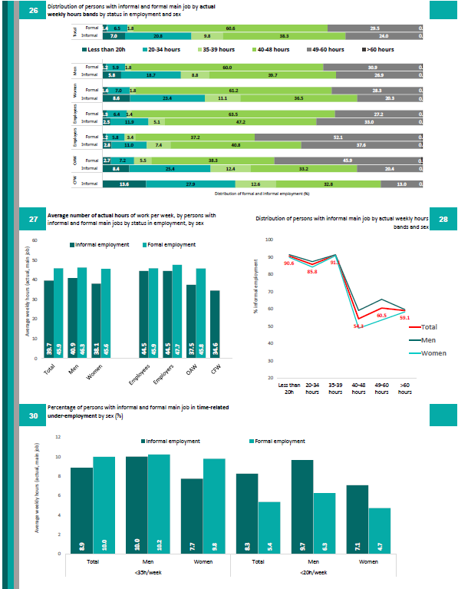
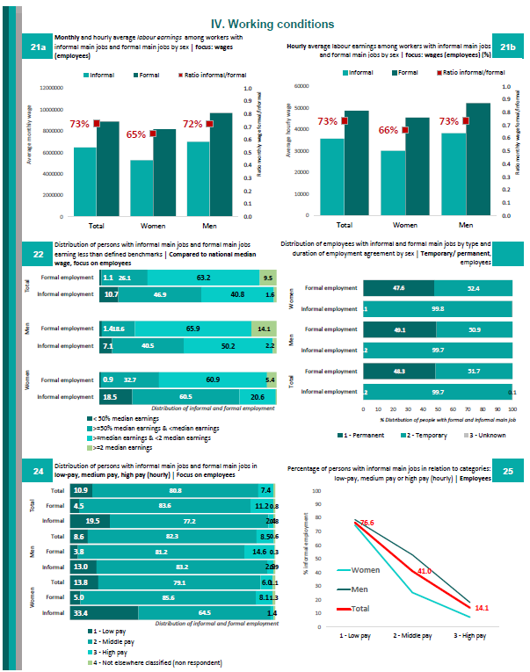
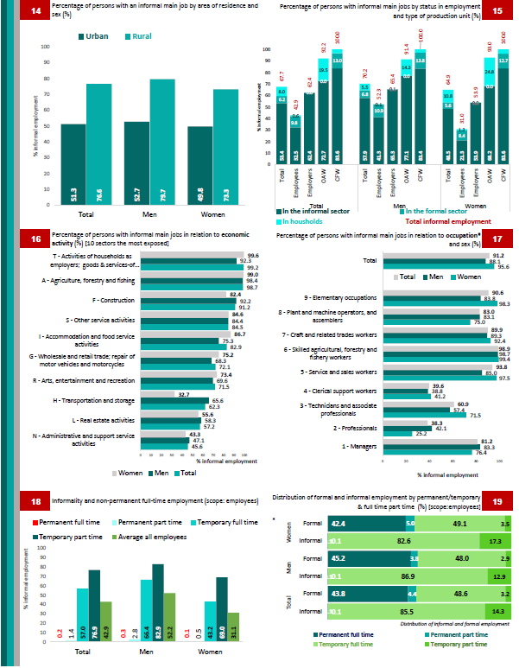
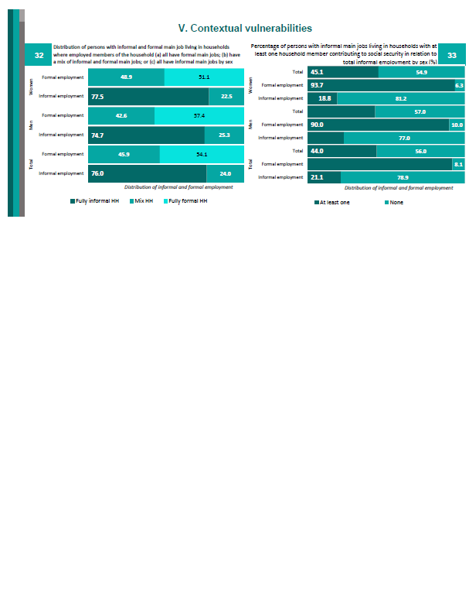
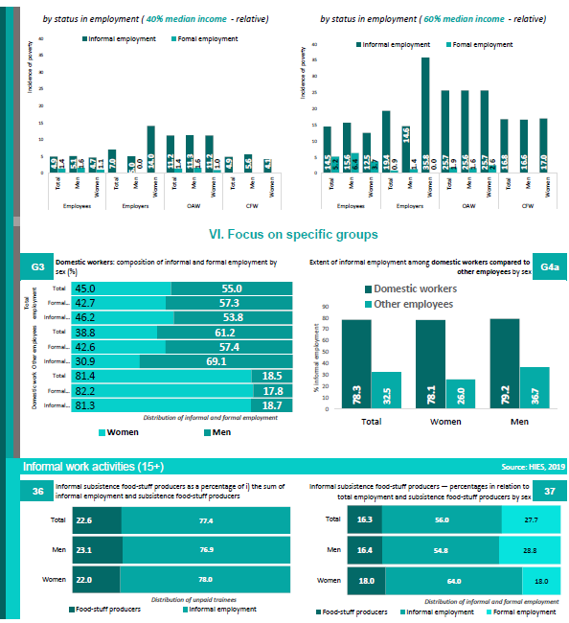
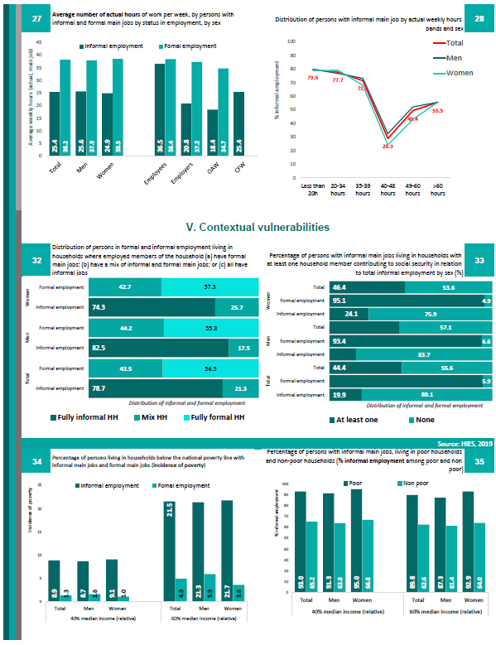
Indicators in the resolution?
A typical country profile
Data widely available for job related indicators: informal and formal employment and employment in the informal sector, formal sector or household own-use production sector
More limited and to be developed for work activites, economic units and contribution to GDP
Vanuatu

Slide 16

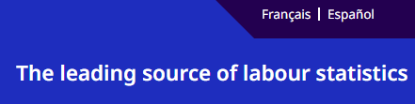
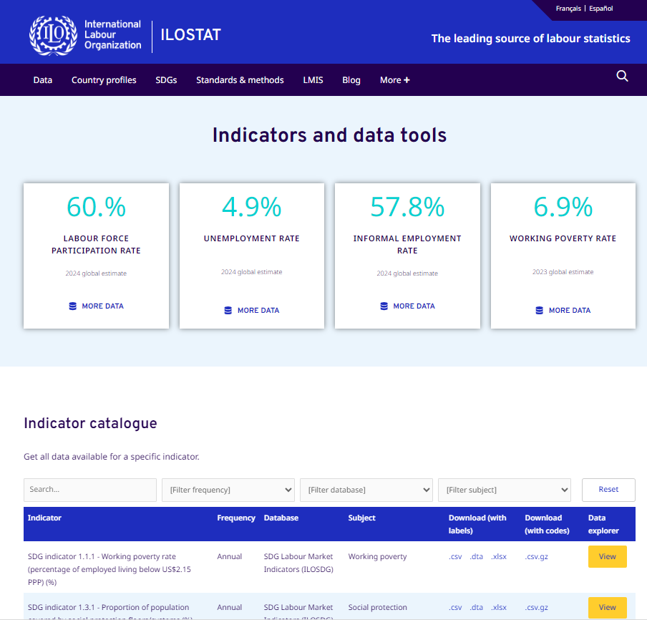

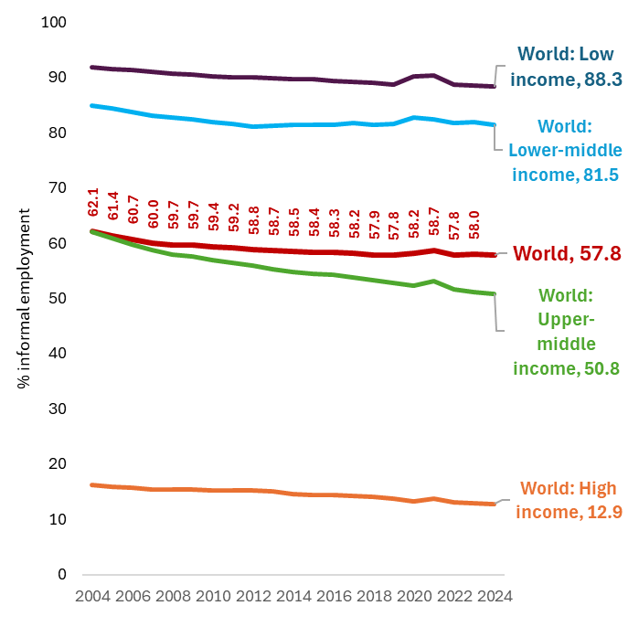
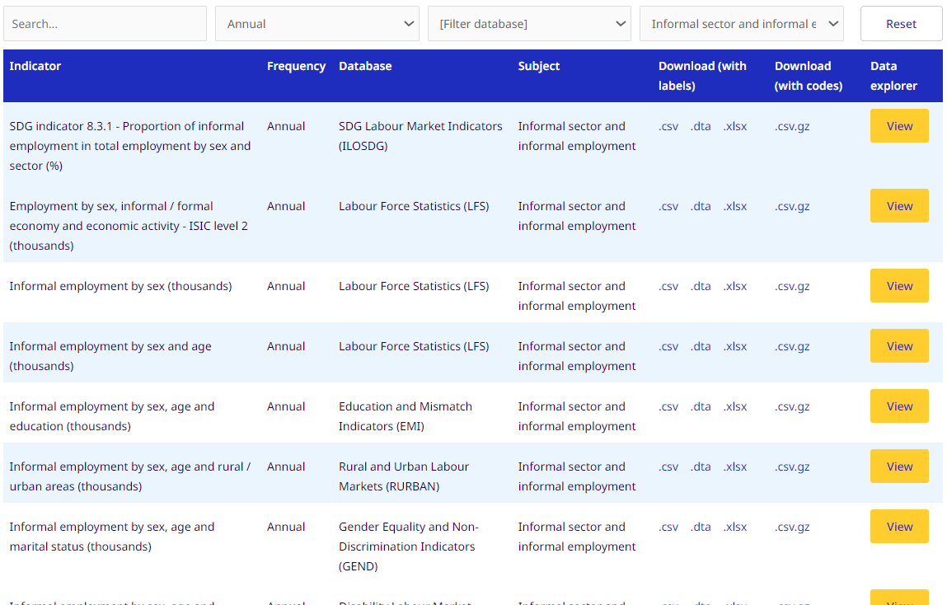
Informal employment indicators in ILOSTAT
Data tools to find and download labour statistics – ILOSTAT
    Informal employment: two sets of indicators
          Country level data (analysis of national survey micro data)
            Harmonized variables; years/quarters depending on national data availability
            Proposed disaggregation
              Socio-Demographic characteristics: sex, age, education level, disability status, migrant status / country of birth / citizenship; Household type / marital status / presence of children; area of residence
              Employment features: Economic activity (ISIC); Occupation (ISCO); Status in employment (ICSE); Public / private sector; Economic class (working poor); Working-time arrangement; Hours actually worked; Type of contract; Multiple job holders; Size of establishment.
Under ‘filter subject’
Informal sector and informal employment
          ILOSTAT modelled data | Regional & global estimates -
            One indicator: SDG8.3.1: share of informal employment by sex
            Regional & global estimates from 2004-2024
            (no dissemination of estimated country value)

Slide 17
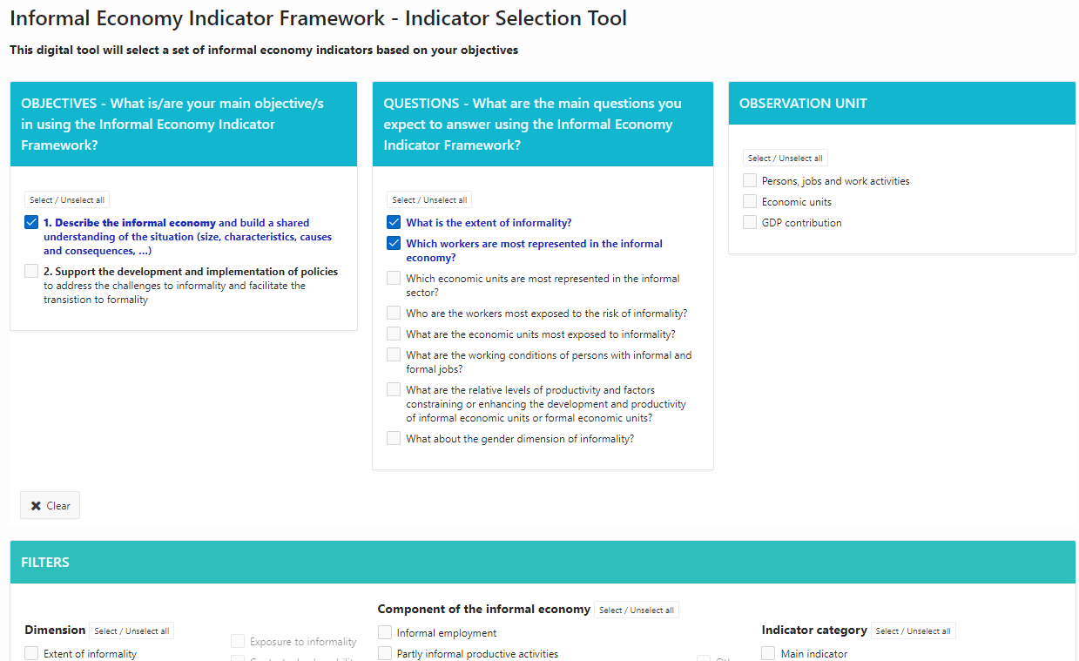
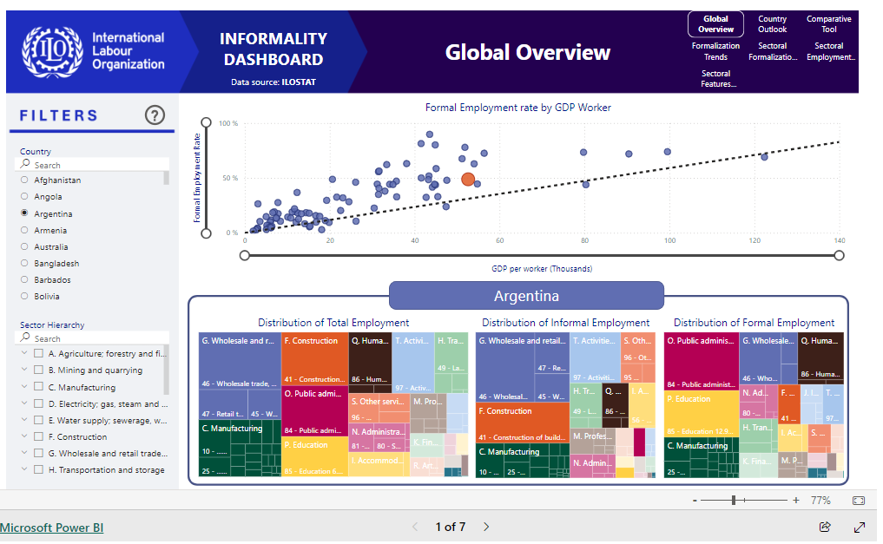
@ Useful links
          The informal economy indicator framework
            Room document 5 – Contextualising informality: The Informal Economy Indicator Framework
            Informal Economy Indicator Framework - Indicator Selection Tool: a digital tool to select a set of informal economy indicators based on your objectives
          Access to data
            In ILOSTAT: Data tools to find and download labour statistics – ILOSTAT (country data and ILO modelled estimates for SDG 8.3.1)
            ILO informality dashboard: country level data explored through a sectoral perspective (latest available and trends)
          Global and regional estimates (informal employment)
            Women and men in the informal economy: A statistical update

Slide 18
From the indicator framework to indicators included in the resolution
Units of reference
Persons, jobs and work activities
Economic units
Informal productive activities (contribution to GDP)
Informal employment
[§§128-133]
Partly informal activities [§134]
Work activities (other) [§135]
Informal employment
[§§128-133]
Informal employment
[§§128-133]
Informal employment
[§§128-133]
Informal employment
[§§128-133]
Partly informal activities [§134]
Work activities (other) [§135]
Informal sector
Partly informal activities [§134]
Work activities (other) [§135]
Main dimensions
Partly informal activities
Extent of undeclared earnings & hours
(other) Informal work activities
Extent of informality among essential forms of work
If times allows: quick presentation of the indicators recommended in the resolution concerning statistics on the informal economy
Extent of informality
Headline indicators
% of informal employment
Prevalent forms of informality
Characteristics of workers in informal employment compared to workers in formal employment
Workers most at risk of having informal jobs
Extent of informality of economic units
Extent of informality
Extent of informality
Contribution to GDP
2. Composition of informality
2. Composition of informality
Characteristics of informal economic units & owners
3. Exposure to informality
3. Exposure to informality
Economic units & owners most at risk of operating informally
Session 3.1
4. Working conditions & productivity
4. Working conditions & productivity
4. Working conditions & productivity
4. Working conditions & productivity
Levels of protection (job related) & working conditions
Productivity & eco performance; underlying factors
Session 3.2
+ Levels of protection & vulnerability within households
5. Contextual vulnerabilities
5. Contextual vulnerabilities
5. Contextual vulnerabilities
Legal & institutional framework
6. Other structural factors
Session 3.3
6. Other structural factors
Structure of the labour market and of the economy

Slide 19
Data sources and guidelines for data collection

Slide 20
Introduction
  Overall objective: to compile statistics on informal productive activities carried out by persons and economic units in a harmonious and comparable manner from different data sources => enhancing and building on complementarities between data sources and ensuring data quality
  Key issues:
  Need for different but complementary data sources which calls for harmonisation across sources and for collaboration between different national institutions
  Importance of the quality of the data generated and the factors that influence such quality and reliability of results and their interpretation
  Implications of different sources in relation to population coverage, unit of observation and component of the informal economy concerned, ability to apply definitions, issues covered and range of data and indicators generated:
    Surveys and censuses referring to
      Persons, jobs and work activities
      Economic units
    Administrative records

Slide 21
Multiple complementary sources of data
Quality issues
Data Sources
117-118
Planning the system of statistics on informality: close attention paid to methodologies used to ensure such quality
Objective. Compile data on informal productive activities carried out by persons and economic units in a harmonious and comparable manner
Methodologies used
Concepts applied
Multiple components of the informal economy (different reference units)
+ multiple “dimensions”
Call for multiple complementary data sources
For any data source
Quality of data generated (precision, bias)
+
Comparability across sources
Harmonization across sources and institutions
Enhanced
comparability
Data use. Ensure adequate use of data & enable clear and appropriate interpretation of the statistics
Data quality assessed and reported on transparently
Metadata (source, concepts, methodologies, etc.) published alongside any published data.
Close collaboration between different national institutions
Use most recent relevant ILO methodological guidance

Slide 22
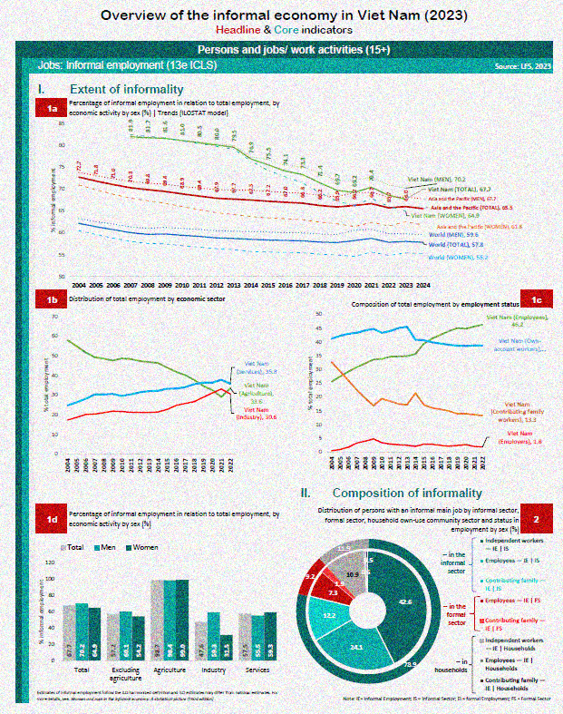
Data sources for persons, jobs and work activities

Slide 23
Multiple sources for persons, jobs & work activities (1)
Data Sources
119-121
Household surveys/ LFS/ mixed-(1-2/1-2-3) surveys [§119]
Other household surveys
[§ 120]
Other specialized household surveys [§121]
Recommended source to assess/identify and monitor the:
Extent of informal/ formal jobs
Workers most represented among informal & formal jobs
Workers most exposed to the risk of having an informal job
Levels of protection & vulnerability and working conditions of persons in formal and informal jobs
Drivers associated to socio-demo & employment related features + structural drivers associated to the structure of the labour market
Surveys on poverty and living standards, or household income and expenditure surveys
Assess levels of vulnerabilities & protection among workers with informal or formal jobs in and beyond the world of work, notably:
  the relationship between informality and poverty
  the level & composition of income/ expenditure from all sources at individual & household levels
  access to social protection beyond job-related contributory social security
Time Use Surveys
  e.g. participation and time spent in informal unpaid work such as the own-use provision of services (in particular informal unpaid domestic work and care work).
Specialized surveys on specific groups of the population (e.g. agriculture, digital platform employment, labour migration, persons with disabilities)
  Relevant for specific working activities, or specific subgroups of the population (often at greater risk of informality) whose total number might be too small in LFS samples to produce reliable statistics.
Informal employment
Recommended source for collecting data on informal employment
Source to identify levels of vulnerability of persons with informal or formal jobs incl. non-job related, within households, beyond work
Provided that the sample size permits estimates with an adequate level of precision AND that questions identifying informal/ formal jobs are included
Possible statistical source for subgroups
Provided that questions identifying informal/ formal jobs and other work activities are included
household-based surveys, particularly LFS: important data sources for producing statistics with persons & jobs as reference units
Detailed sequences of questions on the characteristics of jobs
Generally include less detailed sequences of questions on labour
may be designed with smaller sample sizes
Recommended source for collecting data on informal employment
Formal employment with partly informal activities
Can be used to assess formal employment with partly informal activities
Possible statistical source for subgroups
Informal work activity
Source that can provide data on essential work activities
Statistical source for informal work activities

Slide 24
Multiple sources for persons, jobs & work activities (2)
Data Sources
122 &125
Population Censuses
[§ 122]
Administrative records
[§ 125]
Provide the basis for designing survey samples (sample frame), integrating national data sources and producing small area estimates
Can be used to create estimates on informal employment
Might be of relevance for creating estimates for small geographic areas (incl. islands) and small population groups
The number of persons covered by formal arrangements can, for example, be estimated in taxation systems, employment services and social security schemes
  can be used for indirect estimation of informal employment by estimating formal employment
  can be used as relevant auxiliary information in surveys to further support the identification of formal jobs => Requires that a direct linkage at the level of persons and jobs is feasible in the country
  might also be used to identify formal work activities
Informal employment
Possible statistical source for small groups
Need to limit respondent burden/number of questions → Could require the number of criteria to define formal and informal jobs be limited to a smaller set among those defined in this resolution
Data on formal employment & possibly on formal work => Indirect estimate of informal employment & possibly of informal work activities
The possibilities depend on the structure and content of the country-specific administrative sources
Priority should be given to direct methods (surveys/ censuses) to ensure for more accurate estimations and allow for more in-depth analysis
Formal employment with partly informal activities
Informal work activity

Slide 25
Persons, jobs and work activities:
Structure of the framework and sources
Informal productive activities by persons in the informal economy
PERSONS
INFORMAL WORK
Main intention of the productive activities
For pay or profit
Informal productive activities in relation to employment
Not for pay or profit
Informal productive activities: other forms of work
Informal productive activities by persons
Formal employment with partly informal activity
Informal employment
Informal unpaid trainee work. Informal organization-based volunteer work
Informal other work activities
Informal own-use production work.
Direct voluntary work
Carry out the work for Economic units in:
Formal sector
HOPC sector
Formal sector
Informal sector
HOPC sector
Formal sector
Informal sector
Household own use production and community sector (HOPC)
Relation to SNA production bundaries
Goods and services
Goods
Services
SNA production bundaries
SNA general production bundaries
Household surveys/LFS
Mixed surveys (1st phase)
Sources
Other household surveys
Other specialized household surveys (incl. time-use surveys)
Population Censuses
Administrative records

Slide 26
Data sources for economic units

Slide 27
Multiple sources for economic units (1)
Data Sources
123-125
Enterprise based sources
[§ 123-124]
Administrative records
[§§ 125]
Such as enterprise-based surveys, mixed surveys (1-2 and 1-2-3 surveys), economic census
Main data sources for the analysis of informal sector and formal sector economic units, notably on:
  Extent informality and characteristics of informal economic units and owners (compared to formal ones)
  Economic units most exposed to informality
  Factors constraining or enhancing the economic performance of economic units: labour inputs, other production related factors, business environment, etc.
  Linkages between formal and informal sector economic units
  Production and contribution to GDP
Economic units covered by formal arrangements can be identified for example in business registers, tax registers:
  can be used for indirect estimation of informal sector by estimating the formal sector
  can be used as relevant auxiliary information in surveys to further support the identification of formal economic units
Informal sector
Best source to assess informal sector eco units
Economic censuses, enterprise-based surveys and mixed surveys (phase 2) are the main data sources for the analysis of informal sector and formal sector economic units
Ensure that the scope of activities and type of economic units covered (size, place of work, economic activity and institutional sector) do not imply an exclusion of economic units likely to be informal
Attention to be paid to the sampling methods and frame used.
Indirect (extent of informal sector)
The possibilities to do so depend on the structure and content of the country-specific administrative sources
Priority should be given to direct methods (surveys/ censuses)
Informal production and informal labour input
Can provide some elements

Slide 28
Economic units: Relation between the framework and sources
Enterprise-based sources
Sources
Mixed surveys (phase 2)
Administrative records
LFS
Mixed surveys (1st phase)
Other spec. household surveys

Slide 29
GroupWork

Slide 30

Units of reference
Main dimensions/questions
Persons & jobs/work activities
Informal employment/ informal work activities
Economic units
Informal sector economic units
Informal productive activities: contribution to GDP
20 minutes in total
1. Size and trend of informality
What exists and where are the gaps?
2. Composition of informality
Considering the different dimensions and the main components of the informal economy: jobs (the labour dimension); economic units (enterprises) and their contribution to the economy (the production dimension):
Indicate in the matrix for which dimensions of the informal economy (left) and reference units (top) you do have the necessary information (colour 1), you produce & disseminate indicators (colour 2)
  Simply indicate the name of your country in all cells that you feel relevant
3. Exposure to informality
4. Working conditions & productivity
5. Contextual vulnerabilities
6. Others factors structural

Slide 31
Thank you ! ! !

